Slide 1

Note: The data and information in this document is reflective of a hypothetical situation and client. This document is to be used for KPMG Virtual Internship purposes only.
Sprocket Central Pty Ltd
Data analytics approach

Slide 2
Note: The data and information in this document is reflective of a hypothetical situation and client. This document is to be used for KPMG Virtual Internship purposes only.
Agenda
Introduction
Data Exploration
Models
Interpretation

Slide 3
Note: The data and information in this document is reflective of a hypothetical situation and client. This document is to be used for KPMG Virtual Internship purposes only.
Introduction
Who are the target Customers of Sprocket Central Pty Ltd’ out of the new 1000 customer list ?
This was analyzed in categories of ;
-Wealth Segment
-Job Industry Segment
-The State they are from

Slide 4
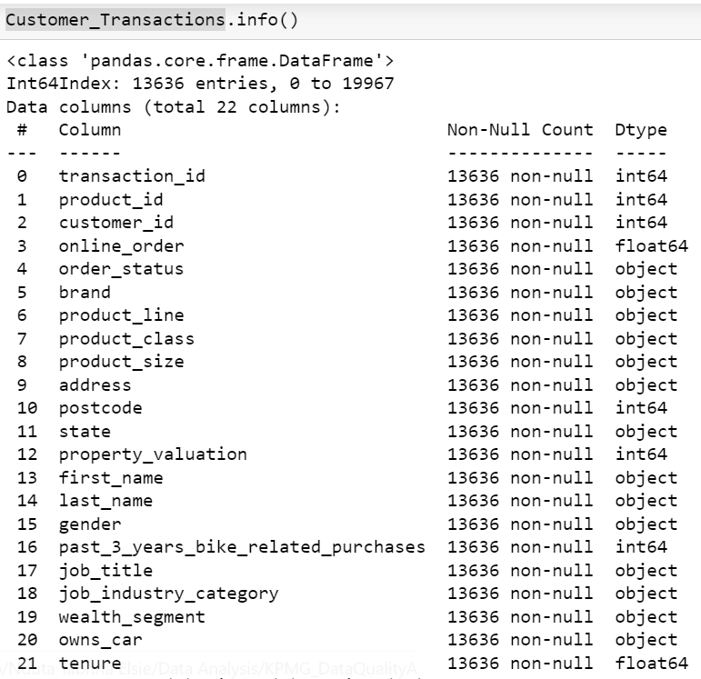
Note: The data and information in this document is reflective of a hypothetical situation and client. This document is to be used for KPMG Virtual Internship purposes only.
Data Exploration
Combined the datasets (Customer Address ,Customer Demographic ,Transactions) to one collective dataset (Customer Transactions).
The Combined dataset was free of all quality issues .

Slide 5
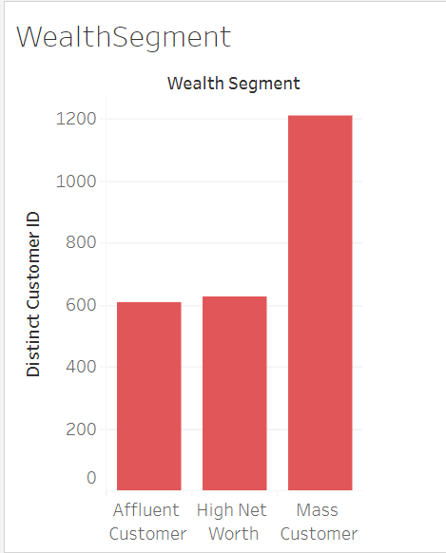
Note: The data and information in this document is reflective of a hypothetical situation and client. This document is to be used for KPMG Virtual Internship purposes only.
Model 1
What Wealth segment are most of our customers in ?
From the Chart most customers are from the Mass Customer segment who are about 1200

Slide 6
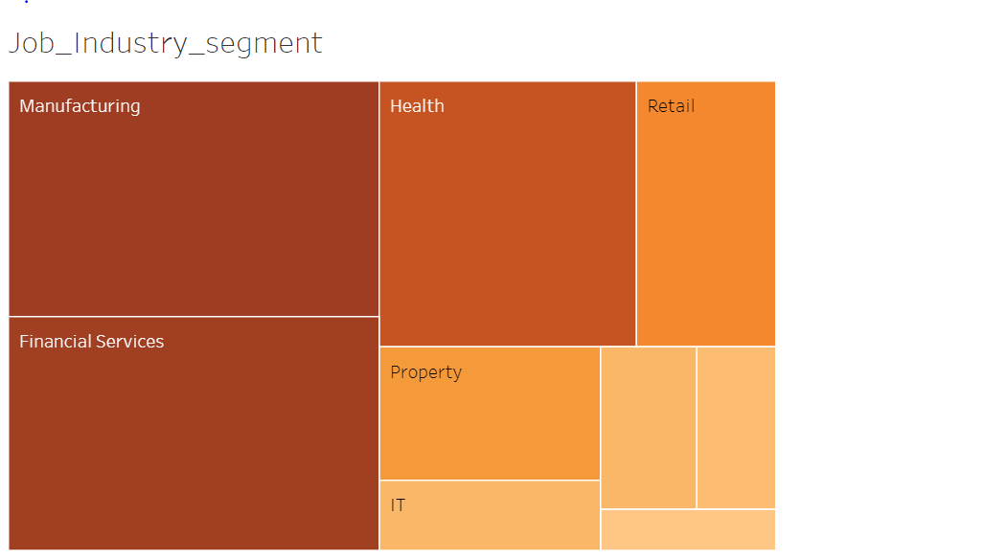
Note: The data and information in this document is reflective of a hypothetical situation and client. This document is to be used for KPMG Virtual Internship purposes only.
Model 2
What Job Industry Segment are most customers in ?
From the Visual most customers are from the manufacturing ,Financial services and the Health industry.

Slide 7
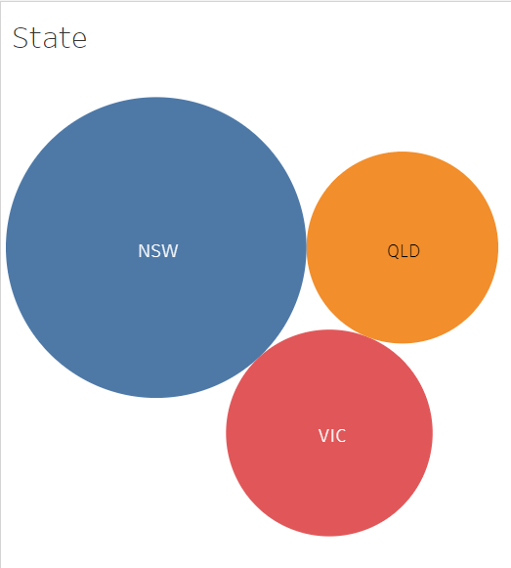
Note: The data and information in this document is reflective of a hypothetical situation and client. This document is to be used for KPMG Virtual Internship purposes only.
Model 3
From Which State are most of our Customers ?
Most Customers are from New South Wales.

Slide 8
Note: The data and information in this document is reflective of a hypothetical situation and client. This document is to be used for KPMG Virtual Internship purposes only.
Interpretation
From the Visuals the target customers should be narrowed down to those in the mass Customer wealth segment, from the job industry segment those working in Health, Manufacturing and Financial Services and in from the New South Wales State.
Place any supporting images, graphs, data or extra text here.

Slide 9
Note: The data and information in this document is reflective of a hypothetical situation and client. This document is to be used for KPMG Virtual Internship purposes only.
Appendix

Slide 10
Note: The data and information in this document is reflective of a hypothetical situation and client. This document is to be used for KPMG Virtual Internship purposes only.
Appendix
This is an optional slide where you may place any supporting items.

